Slide 1
Bhakti Yoga Club
UT Austin Sep 2017

Slide 2
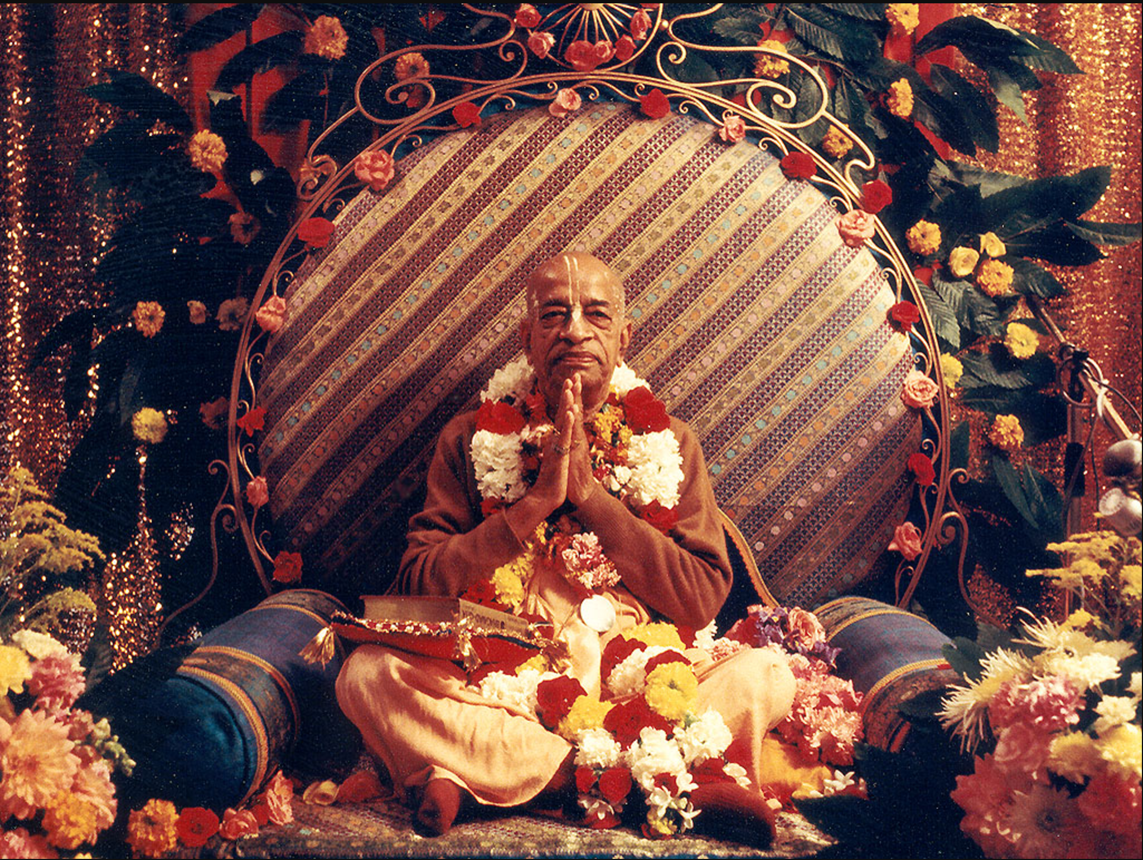
ISKCON Founder Acharya
His Divine Grace A.C. Bhaktivendanta Swami Sril Prabhupada (1896-1977)

Slide 3


Slide 4
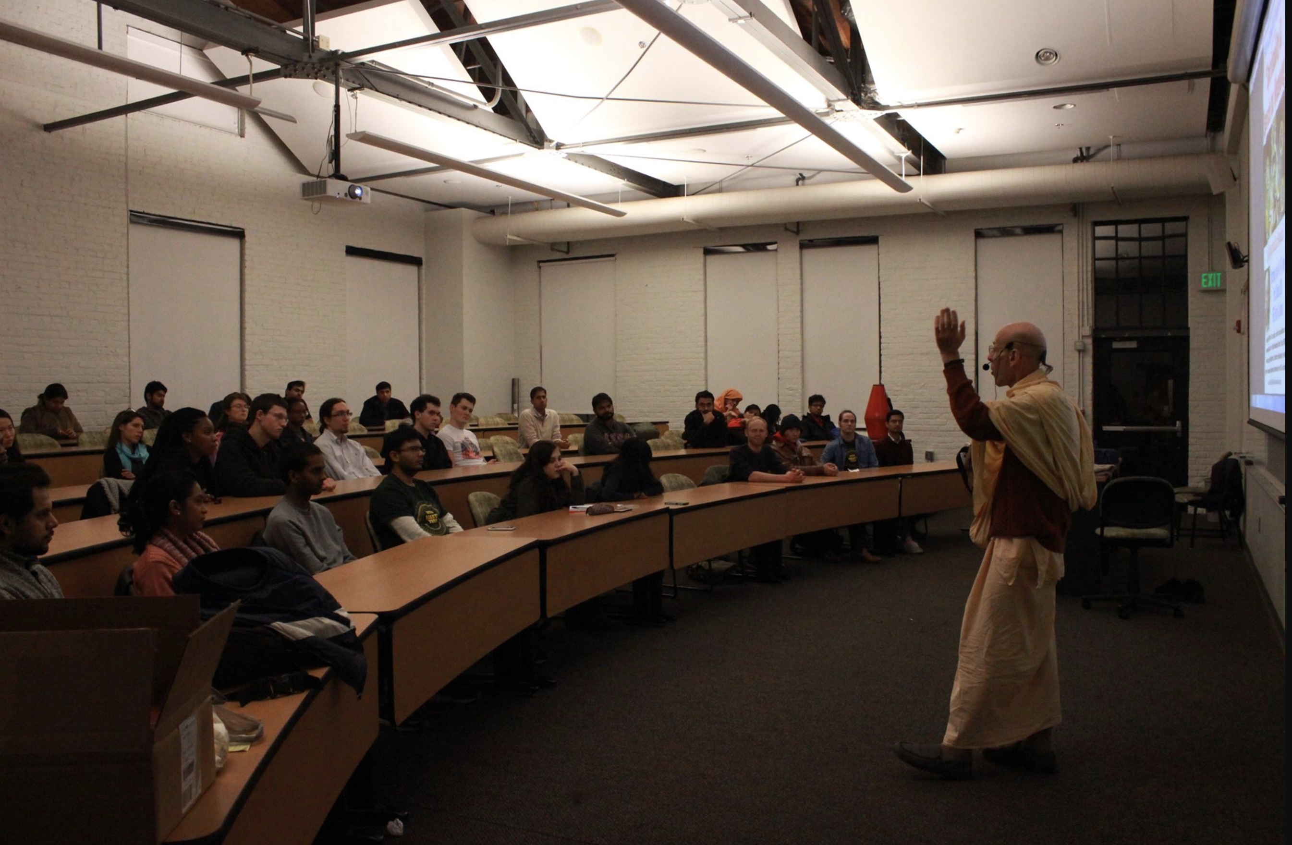

Slide 5
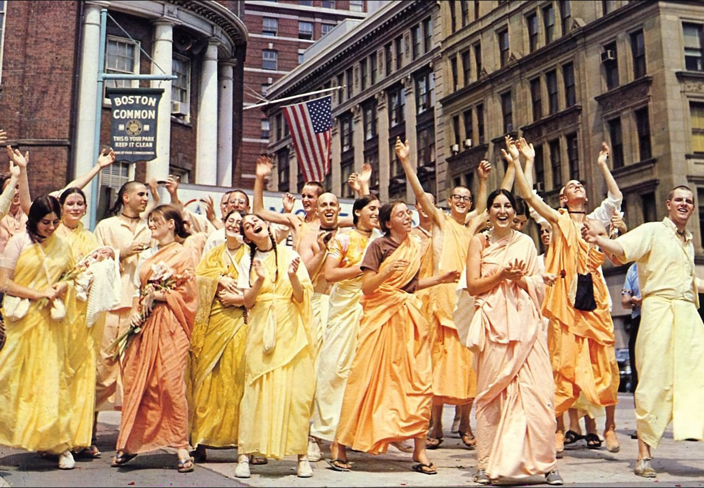

Slide 6
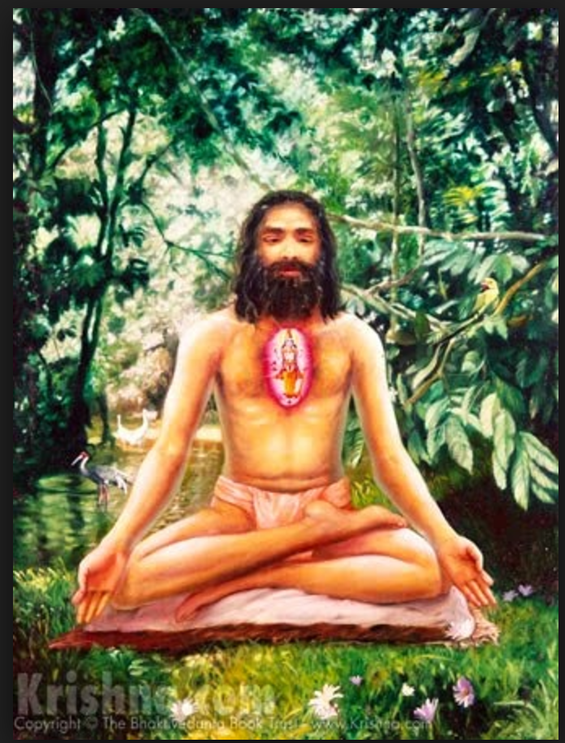
Dhyana yogi meditating on Vishnu in his heart

Slide 7
Who can perform Bhakti Yoga
Anyone
Sages
Man
Woman (Draupadi, Kunti, Mandodhari, Devahuti)
Child (Prahlad Maharaj, Dhruva Maharaj)
Married or unmarried
Old (Advaita acharya, Shabari)
Handicap (Kubja)
Tribals (Guha)
King (Ambarisa Maharaj, King Bahulashva)
Rich (Yudhistira Maharaj)
Poor (Vidura, Sudama, Sruta deva)
Animal (Gajendra)
Demigods (Indra, Vayu, Agni, Varuna)
Demon (Prahlad Maharaj, Vibhishana, Trijada, Bali Maharaj, Vrtrasura)
Bird (Garuda, Jatayu)
Monkey (Hanuman, Sugriva)
Greatest living being (Lord Brahma – secondary creator, visarga purusa)

Slide 8
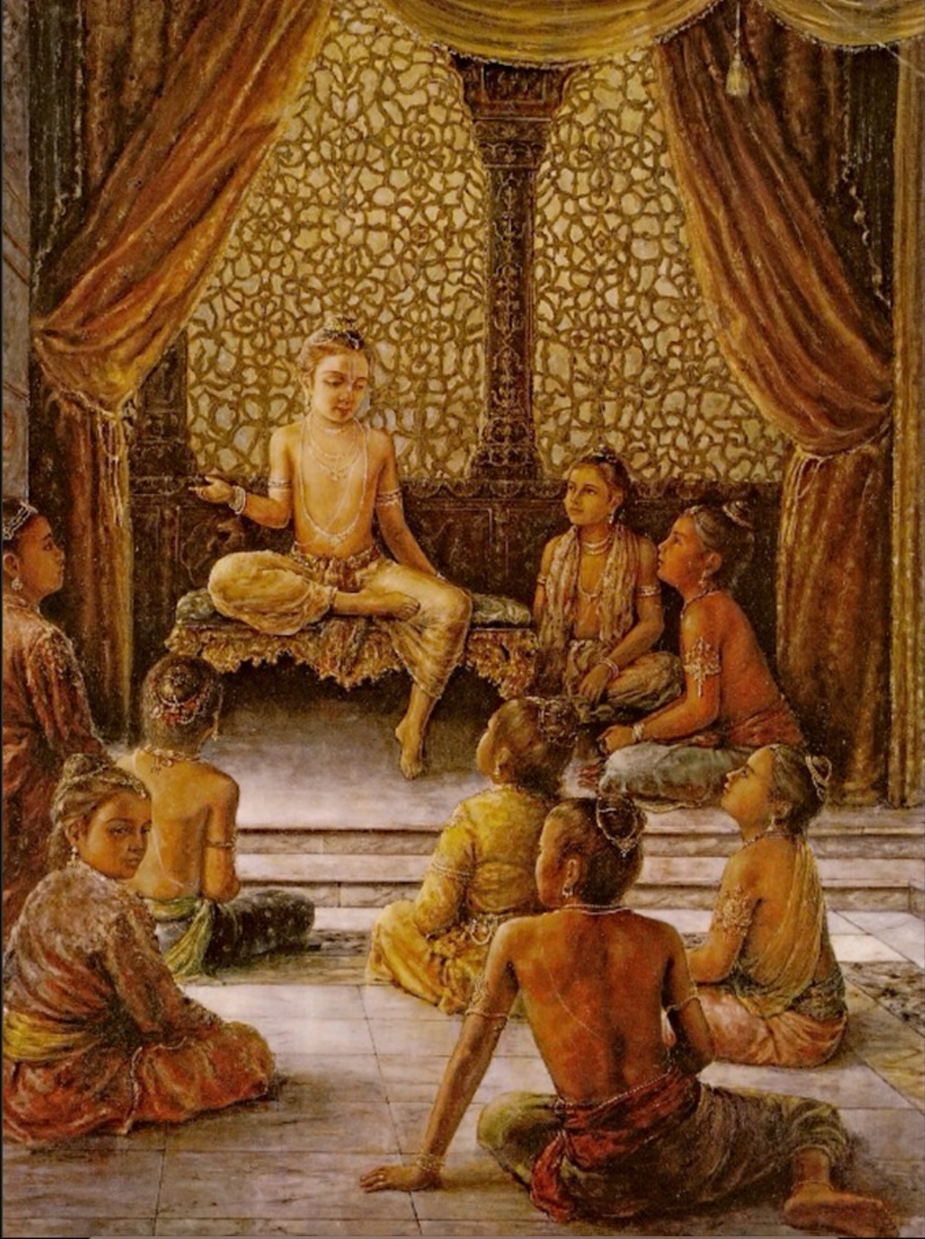
Prahlad Maharaj with his classmates

Slide 10
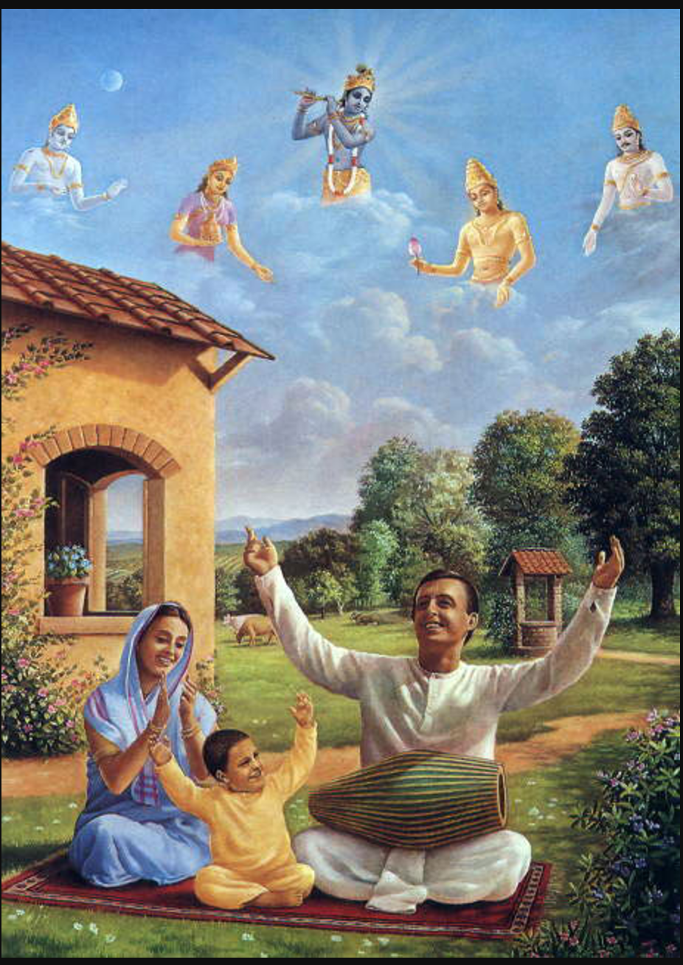

Slide 11
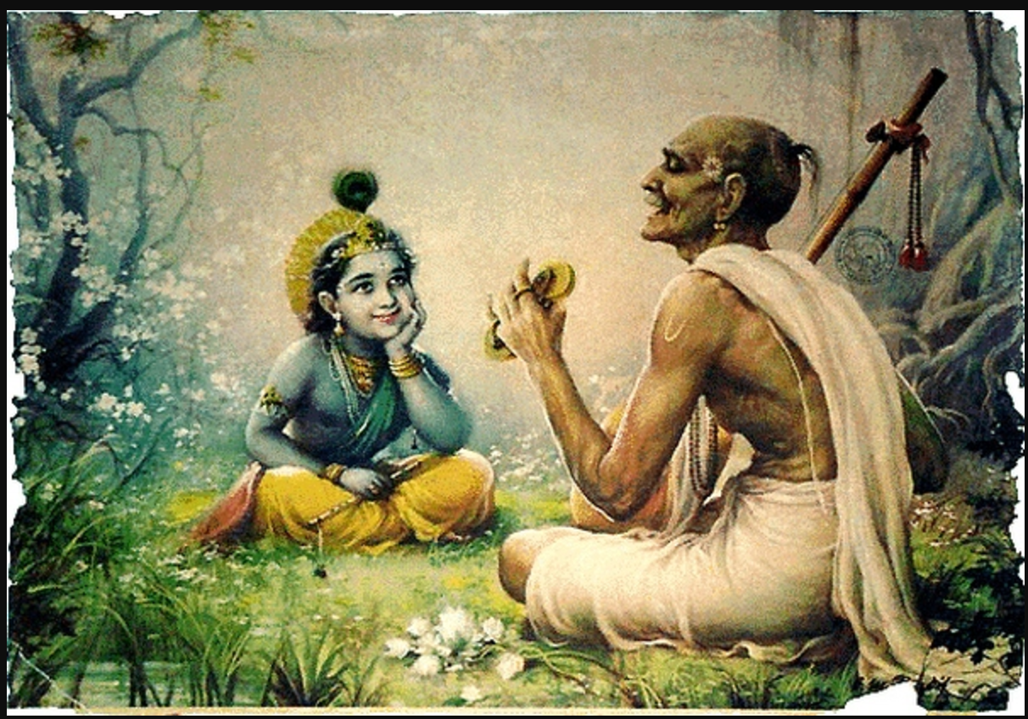
Kirtanam or process of glorification by singing or chanting

Slide 12
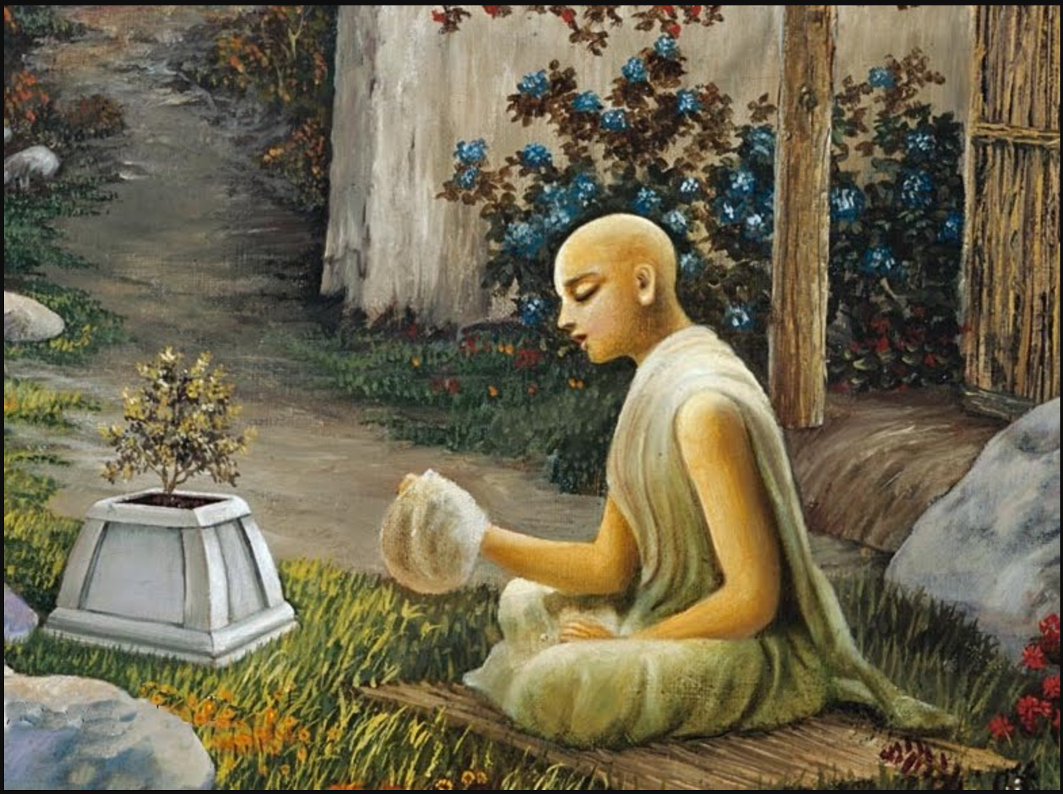
Kirtanam or process of glorification by singing or chanting

Slide 13
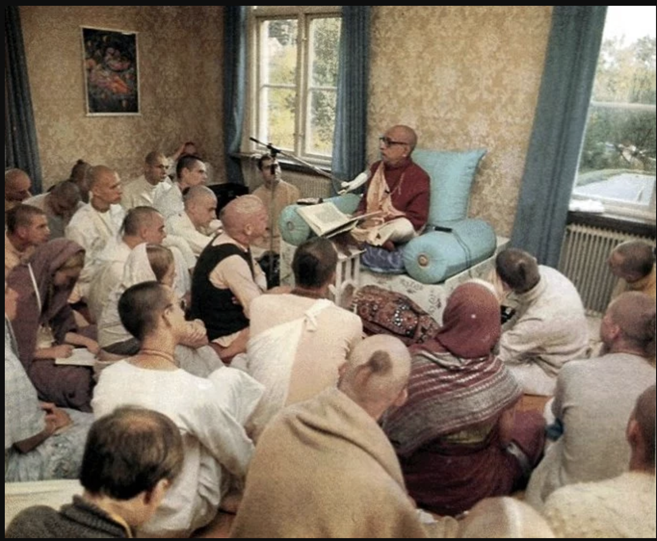
Sravanam or Hearing process

Slide 14
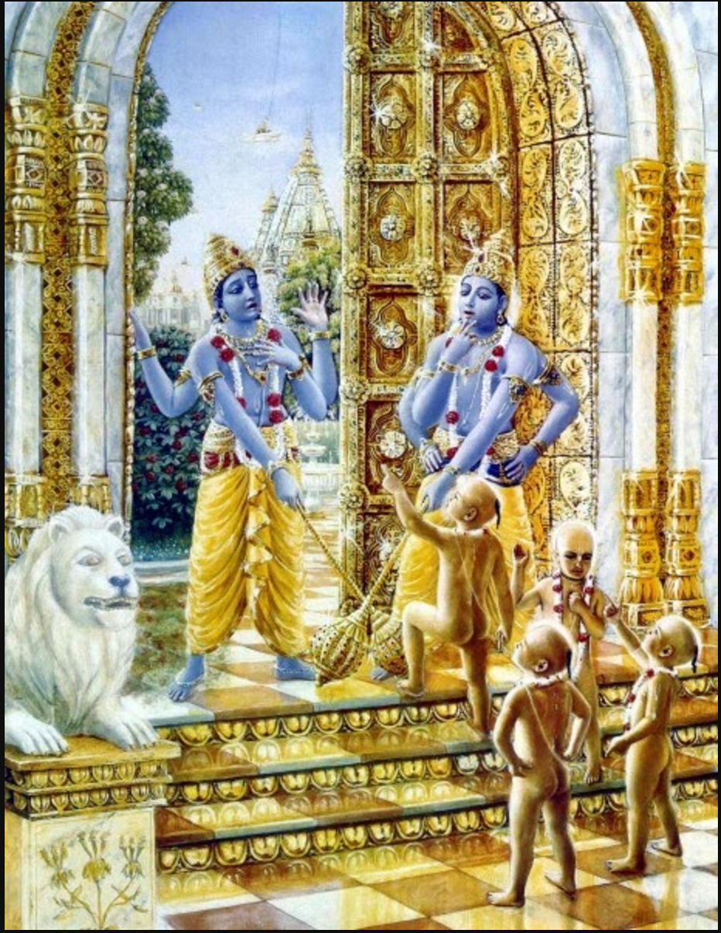
Jaya Vijaya cursed

Slide 15
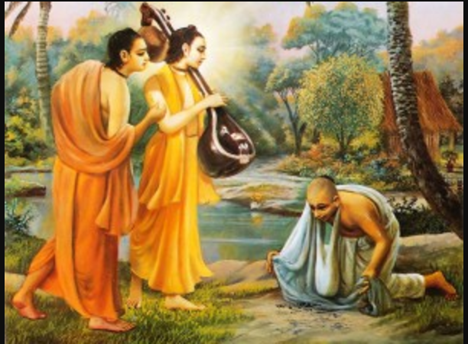
A Pure devotee does not want to harm even an ant
Mrigari, Narada and Parvata Muni

